Slide 1
Warm-core vs. cool-core vortices Combining the prior concepts of: thermal wind and vorticity Background first, then Assignment: slides 25-40
ATM 407, fall 2022
Brian Mapes, Univ of Miami

Slide 2
Ideas you should have in mind
In thermal wind balance, you learned how the slope of pressure surfaces (indicating the PGF) balances the Coriolis force in geostrophic flow
You know that thickness (between pressure surfaces) is proportional to T
θ(x,y) is like T(x,y) at a given level, but θ always increases with height
This gives a 3D view of T around wind jets (next slide)
But wind always blows in closed circuits, so it is more useful to think of vortices as the basic unit of flow.
Then T is understood in terms of warm and cool cores above/below the level where the vorticity is strongest.

Slide 3
p surfaces on a z-coordinate diagram
for NH westerly jet stream in thermal wind balance
→
z
150 mb
thinner mass (Δp) layers,
cooler compared to
← that
big thickness of mass (Δp)
layers: warm compared to that →
200 mb
300 mb
Jet stream
into page
PGF is “downhill”
Coriolis force to R
500 mb
small thickness of
mass (Δp) layers:
cooler, compared to that→
same mass (Δp) layers
are thicker: warmer than
← that
700 mb
1000 mb
North
South

Slide 4
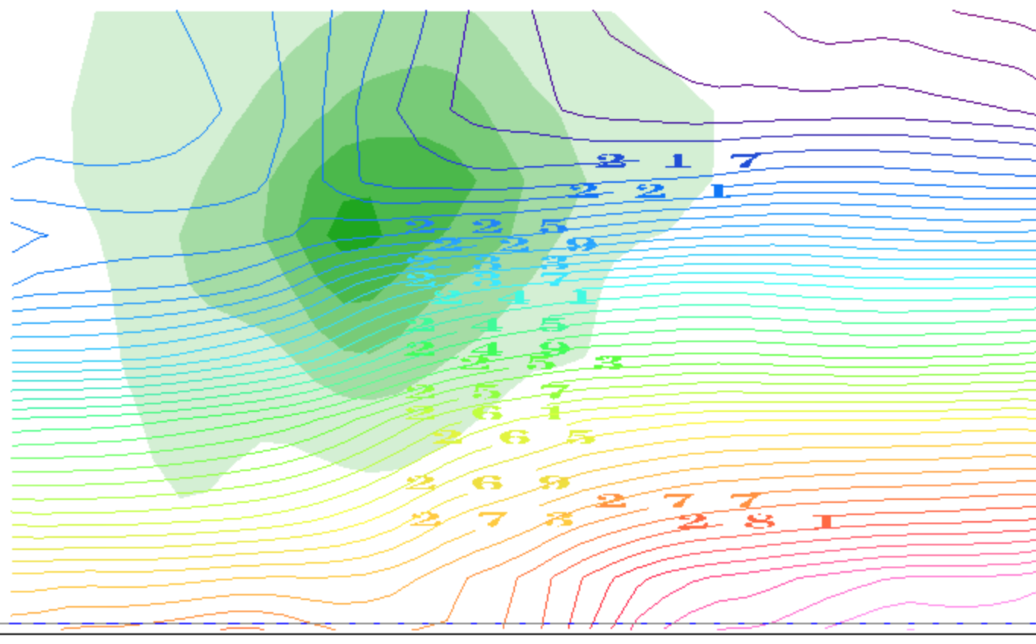
contours of T(K): it decreases with height
(plus the horizontal gradients due to TWB)
thinner mass (Δp) layers,
cooler compared to
← over there
big thickness of mass (Δp)
layers: warm compared to over there →
Jet stream
into page
small thickness of
mass (Δp) layers:
cooler, compared to that→
same mass (Δp) layers
are thicker: warmer than
← that
North
South

Slide 5
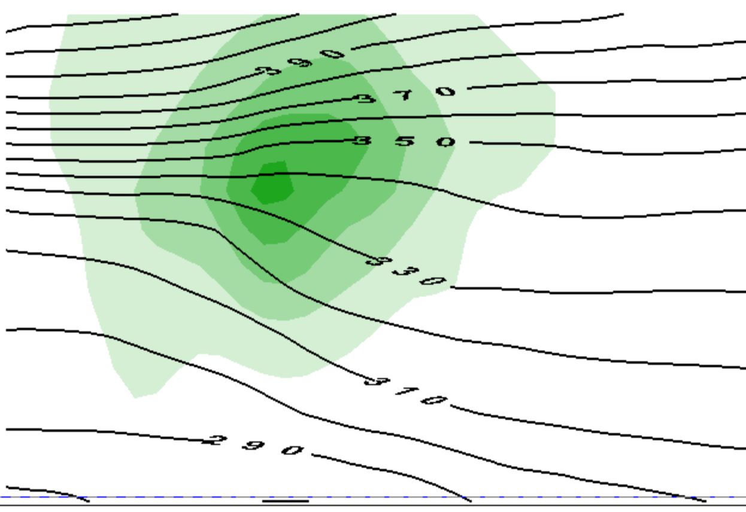
contours of θ(Κ): it increases with height
(plus the horizontal gradients due to TWB)
thinner mass (Δp) layers,
cooler compared to
← over there
big thickness of mass (Δp)
layers: warm compared to over there →
Jet stream
into page
small thickness of
mass (Δp) layers:
cooler, compared to that→
same mass (Δp) layers
are thicker: warmer than
← that
North
South

Slide 6
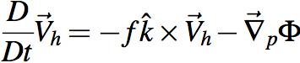
That view emphasized jet streams as the unit of flow
OK, suppose we want to think in those terms.
What is a jet made of?
momentum, or ½ its square KE
per unit mass
What equation governs momentum?

Slide 7
That view emphasized jet streams as the unit of flow
To predict vector momentum V_{h}, need Φ
But that drags thermo into our equation set
must predict T, not just guess its structure by TWB
We work hard to avoid that with vorticity

Slide 8
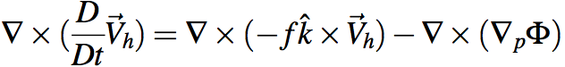
Holy grail of dynamics: get div & ω
Gotta avoid dragging thermo into this via Φ.
Get rid of Φ at any cost. Curl to the rescue!
Ker-CHING!
We are Masters of the Universe with our sexy vector identities!
The grail is in the bag!
Notes:
\nabla \times (\frac{D}{Dt} \vec V_h) = \nabla \times (-f \hat k \times \vec V_h) - \nabla \times (\nabla_p \Phi)

Slide 9
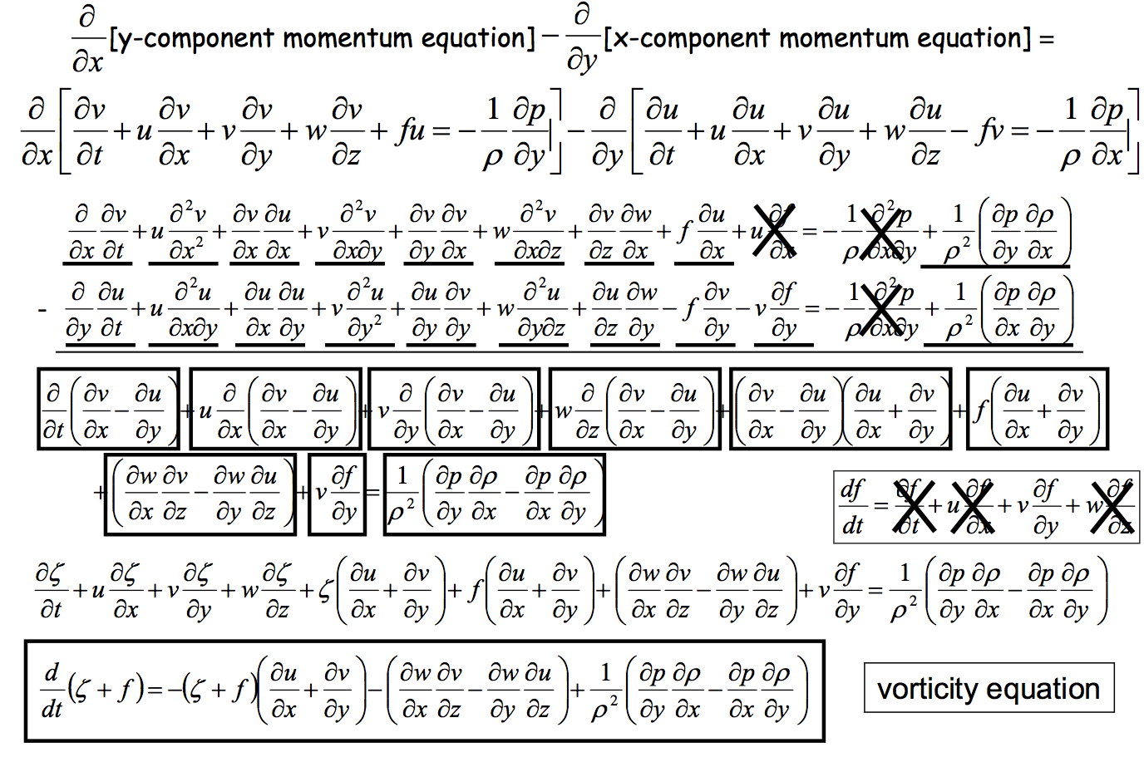
Heh heh ... did I say "any cost"... ? gulp
Can we scrape back some of these cobwebs?
Wait a sec, what's this??

Slide 10
This view emphasizes vortices as the unit of flow
To predict vorticity, we just need vorticity
induced wind drops like 1/distance
vorticity itself is advected by wind like a tracer
plus complications
advection of planetary vorticity f →Rossby waves
divergence term can be rolled up into potential vorticity

Slide 11
So what’s the TWB structure of a vortex?
In this case, one near the tropopause (like the jet stream)

Slide 12
This is only half the story of a cyclone
cooler than
← that
warmer than
that →
Jet stream
into page
cooler than
that→
warmer than
← that

Slide 13
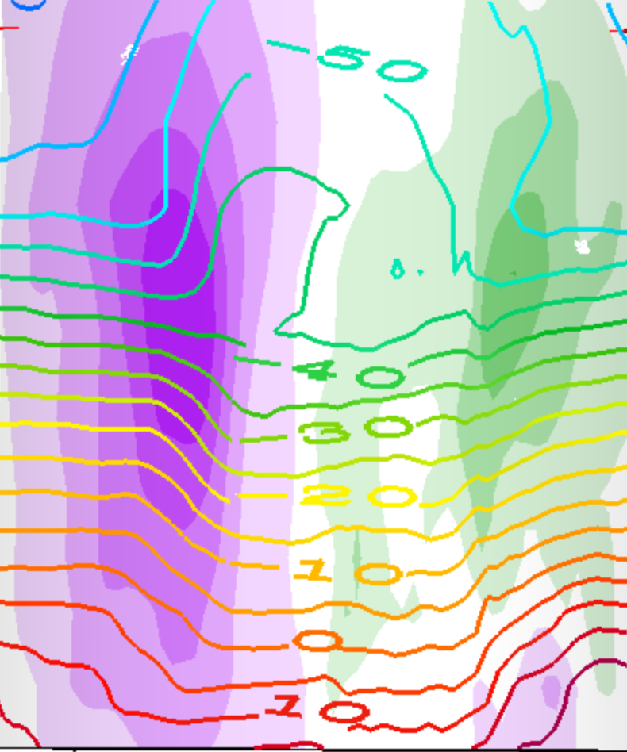
This is a whole cyclone (two jets)
T(K) contours
cooler than
that →
warmer than
← that
cooler than
← that
warmer than
that →
warmer than
that →
cooler than
← that
cooler than
that→
warmer than
← that

Slide 14
This is a whole cyclone (two jets)
T(K) contours
warmer than
← that →
above the cyclone
cooler than
← that →
below the cyclone

Slide 15
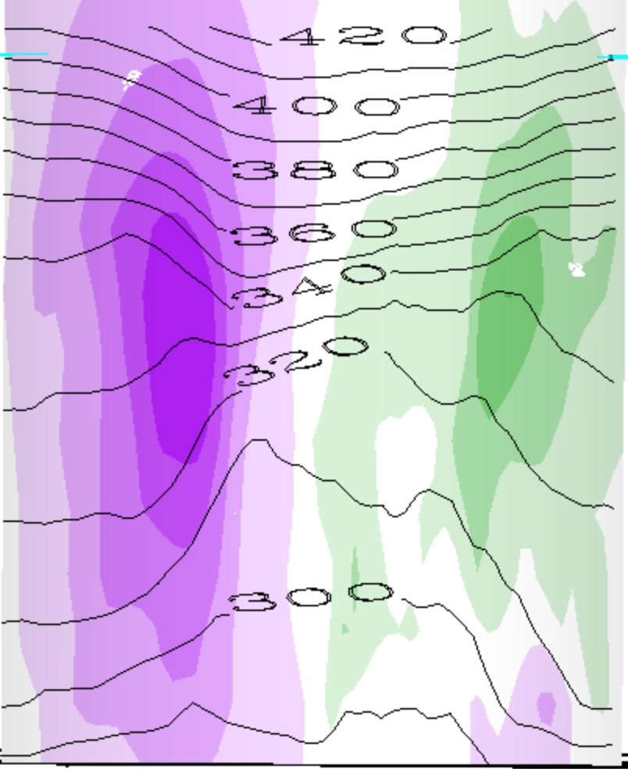
This is a whole cyclone (two jets)
θ(K) contours
warmer than
← that →
above the cyclone
cooler than
← that →
below the cyclone

Slide 16
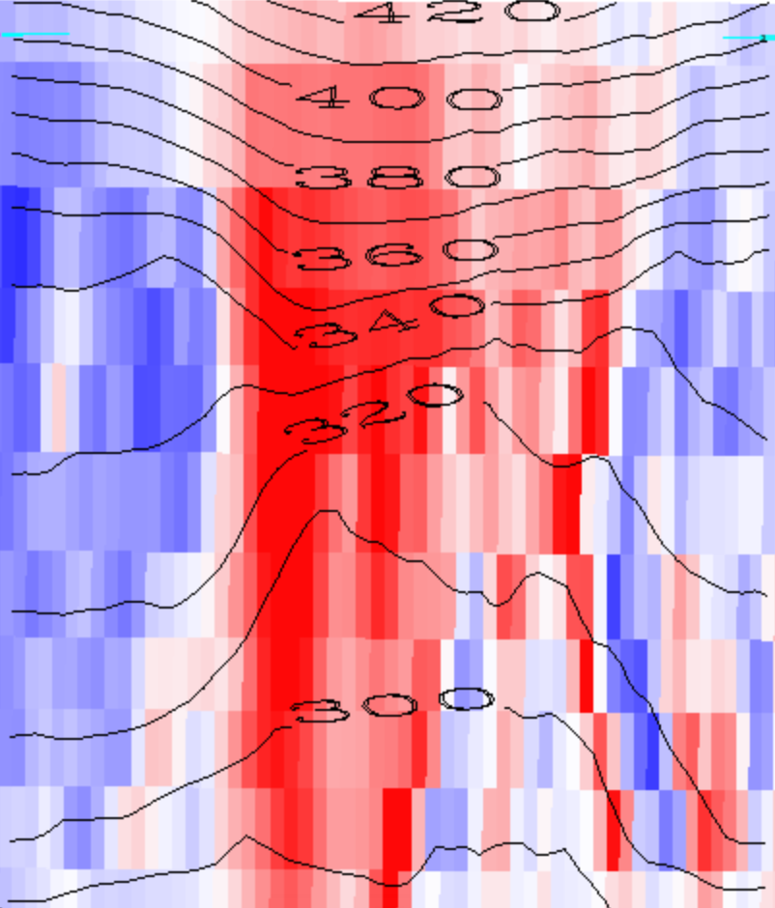
Red is positive vorticity , θ(K) contours
warmer than
← that →
above the cyclone
cooler than
← that →
below the cyclone

Slide 17
Red is positive vorticity , θ(K) contours
warmer than
← that →
above the cyclone
Cyclonic Vortex
cooler than
← that →
below the cyclone

Slide 18
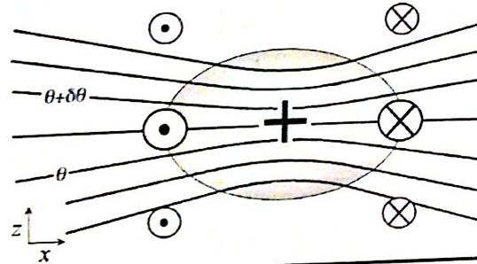
Generalization: PV
1. We will see that every cyclonic vortex obeying Thermal Wind Balance TWB, with vertical (hydrostatic) and horizontal (geostrophic or gradient) force balances, looks similar to this (maybe stretched or shrunk):
PV > 0

Slide 19
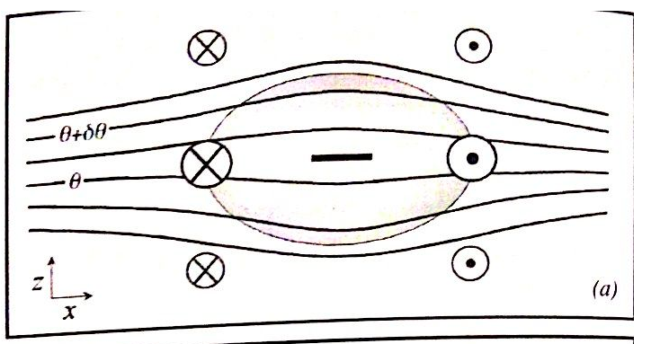
Balanced anticyclones exist too...
Just the opposite of a cyclone...
PV < 0

Slide 20
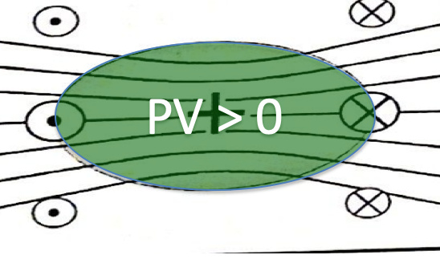
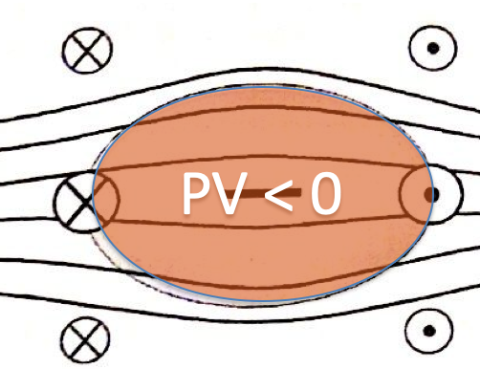
PV features: the essence of a vortex (or trough or ridge)
Both the vorticity (arrows in/out of page) and the static stability (scrunching of θ surfaces) are positive in a N.H. cyclonic PV feature…
… and negative in a N.H. anticyclonic one

Slide 21
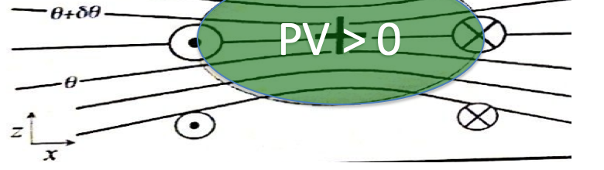
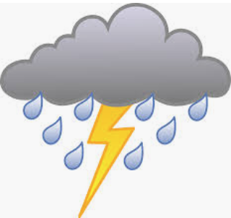

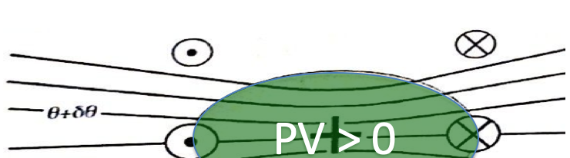
Since our main weather concern is in the lower troposphere (where water is),
This is called a cool core cyclone:
This is called a warm core cyclone:

Slide 22
uq (green) flows up mountains, and up cool-core tilted isentrope

Slide 23
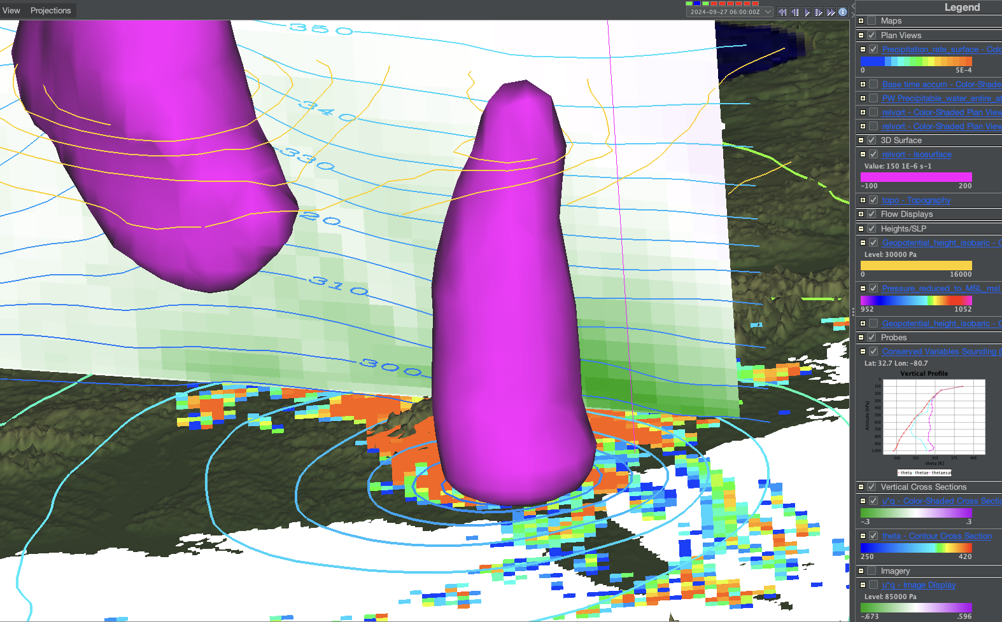
uq (green) flows up mountains, and up cool-core tilted isentrope

Slide 24
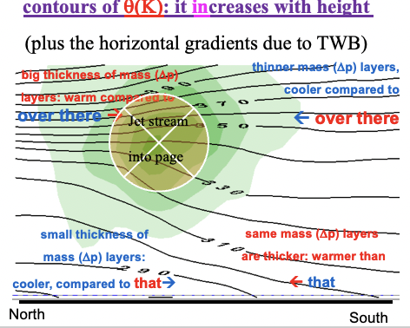
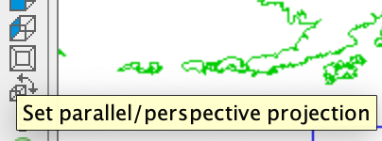
1. a ‘jet stream’ cross section
Find a clean, clear example of momentum feature (“jet stream”), and place the cross section probe across it. Turn off extraneous displays.
Make a cross-section slide, like slide 5 or 12, for your jet stream. Make your slide briefing-quality, clear enough that others could see the location and time and reproduce the figure if needed.
This perspective view →
Is useful for seeing the
Map while viewing a
cross section.

Slide 25
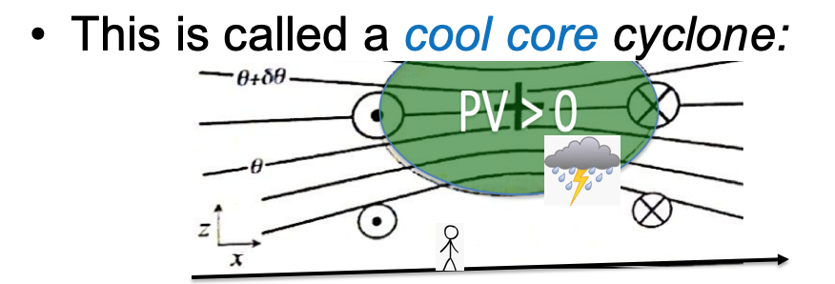
2. A ‘cool core cyclone’ section
Make a slide for a feature like this. Again, please aim for presentation or briefing quality, with all necessary information legible and no extraneous junk displays.

Slide 26
Find the paradigms game!
In the following slides, make and label and explain some nice clear illustrations like slides 13-17, but for
a warm core anticyclone
a warm core cyclone
a cool core anticyclone

Slide 27
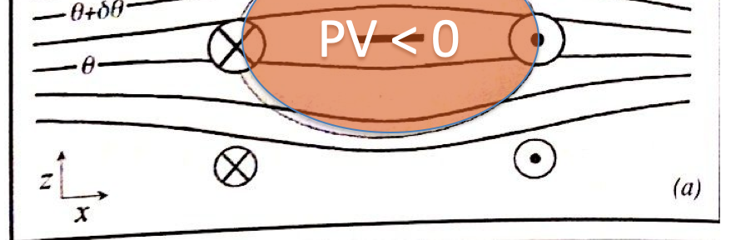
A warm core anticyclone
Where? Describe the situation.

Slide 28
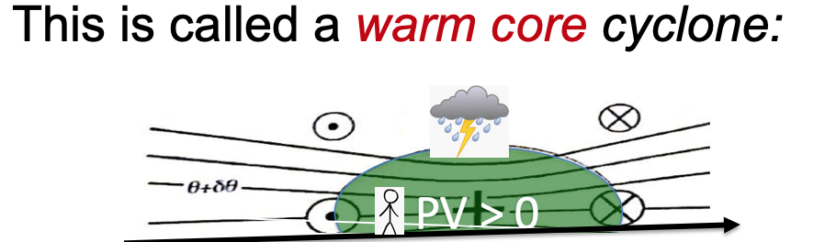
A warm core cyclone
Where? Describe the situation

Slide 29
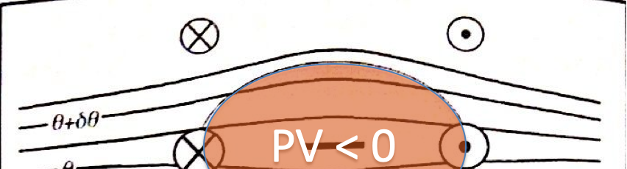
A cool core anticyclone
Where? Describe the situation

Slide 30
Isentropic surfaces
Isentrope contours on the cross sections above are slices of isentropic surfaces
surfaces of constant entropy
or potential temperature, or dry static energy C_{p}T + gz
Let’s learn to see isentropic surfaces
They are almost like material surfaces
because Dθ/Dt = 0 for adiabatic flow
(plus nonadiabatic or “diabatic” complications)
Their vertical motion is air vertical motion!
the holy grail, for clouds+rain (weather)

Slide 31
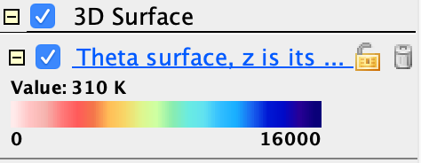

Theta surfaces
In the same bundle, activate (check) the display called “Theta surface, z is its color”
Adjust the value (310K, 330K, 360K)
Use vorticity isosurfaces and cross sections in an illustrated description of its topography.
Is there a mean north-south slope? hint:
What vorticity features (Part I) explain dimples?
What vorticity features (Part I) explain peaks?

Slide 32
Mean slope of the 310K isosurface

Slide 33
A depression in the 310K surface Where? Describe the situation

Slide 34
A peak on the 310K isosurface Where? Describe the situation

Slide 35
Mean slope of the 330K isosurface

Slide 36
A depression in the 330K surface

Slide 37
A peak on the 330K isosurface

Slide 38
Mean slope of the 360K isosurface

Slide 39
A depression in the 360K surface

Slide 40
A peak on the 360K isosurface

